Slide 1
A Seminar on Enhanced Image Steganography using Dual Authentication and Camellia Cipher Encryption
TEAM 1
Team Details:
G. Mahalakshmi Sai Padmini (20EG105415)
B. Vaishnavi (20EG105406)
CH. Shreya (20EG105407)
Project Supervisor:
Dr. K. Madhuri
Associate Professor

Slide 2
Introduction
The issue in the field of image data security and steganography applications is that there isn't a generally effective way to evaluate content similarity between different image datasets and embedding distortions within images. Because the current methods lack a clear methodology, it is difficult to assess the comparability of content among sets of photos. With an emphasis on PNG pictures specifically, a novel technique has been devised.
This algorithm offers a thorough assessment of image similarity while taking embedding distortion into account. This method's main goals go beyond just comparing images; they also include choosing the optimal image, using two authentication methods, and including Camellia Cipher encryption.
This project needs the implementation of the following:
Algorithm Implementation for Cover Image Selection
Dual Authentication Mechanism
Camellia Cipher Integration
Comprehensive Image Steganography

Slide 3
Introduction
The Applications of the above Project involves the following scenarios:
Military Units exchanging critical operational plans and intelligence securely.
Healthcare providers need to transmit the patient records securely to ensure privacy.
Journalists need to receive the anonymous tips securely.
Secure Government agencies use this mode for exchanging the classified information.
Digital Forensic teams need to secure way to exchange the evidence during investigations.

Slide 4
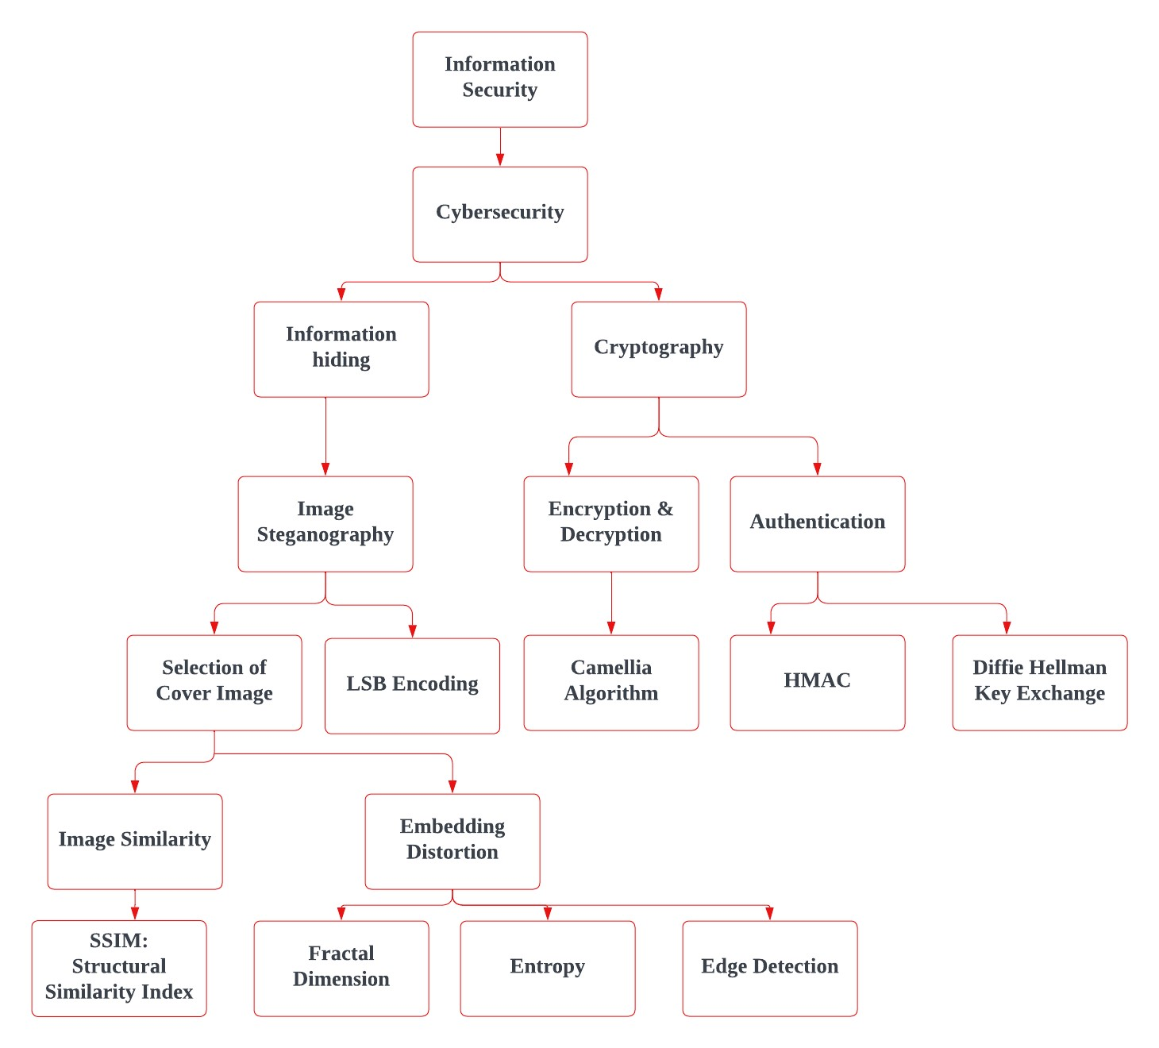
Concept Tree

Slide 5
Literature
Sl.No | Strategies | Advantages | Disadvantages
01 | Cover Image Selection in Image Steganography | 1. Visually appealing integration of hidden information. 2. Enhances the embedding capacity. | 1. Inherent Image Characteristics 2. Perceptual Distortions
02 | Embedding the Data in Transform Domains | 1. Security against frequency based attacks. 2. Has less perceptual distortion | 1.Very complex 2. Introduces high frequency areas with blocking artifacts
03 | Dynamic Steganography | 1.More resistant to detection techniques 2. Improved security | 1.Computational complexity 2. Risk of overfitting
04 | Intelligent Pixel Modification | 1.Better visual impact 2.Less predictable patterns | 1. Computationally Complex 2.Limits the amount of embedding data
05 | Spatial Domain Techniques | 1.Simple technique 2.Provides a good balance between embedding capacity and visual quality. | 1.Perceptible changes 2.Patterns recognized by Steganalysis
06 | Usage of Cryptography | 1.Enhanced security 2. Increased Resistance to Attacks | 1.Increases the complexity of the system 2. Challenge in distributing keys

Slide 6
Literature (cont..) Selected strategy: Cover Image Selection in Image Steganography
Sl.No | Author | Strategies | Advantages | Disadvantages
01 | Zichi Wang et.al. | Cover Selection based on Image Similarity and Embedding Distortion | 1.Effective Dimensionality Reduction 2. Simplifying Complex Metrics | 1. Computational demands for the memory requirements 2. Limits the scalability.
02 | Xinpeng Zhang et.al. | Cover Selection Method using Gaussian Mixture | 1. Enhancing Suitability for Diverse Cover Images 2. Statistical Robustness | 1.Sensitivity to the quality of the input images 2. Computational Complexity
03 | Sumari Putra et.al. | Cover Image Selection based on Frequency based analysis | 1.Resistance to Spatial Domain changes 2.Higher Embedding Data capacity | 1.Exhibits artifacts 2.Not universally applicable for all images

Slide 7
04 | Anqi Qiu et.al. | Cover Image Selection based on Feature Selection | 1.Contextually relevant 2. Higher degree of unpredictability | 1.Continuous adaptation 2. Visual Alteration of the images.
05 | Rafal Najeh Kadhuma et. al. | Steganography with implicit authentication to enhance sensitive data hiding | 1. Providing an additional layer of security without explicitly revealing the authentication process. 2. Protection against tampering | 1.Might still attempt to reverse engineer 2.Manipulate the hidden authentication features.
06 | Zoran Cica et. al. | Implementation of Camellia Encryption Algorithm | 1. Enhances processing speed and throughput by parallelizing encryption operations 2.High Security Level | 1.Increase in the errors if not implemented properly. 2. Limited Public Exposure

Slide 8
Problem Statement
This project addresses a key challenge in steganography, which is the lack of a universally effective method for assessing content similarity across diverse image collections. Previous studies often lacked adaptability to diverse content types, resulting in suboptimal performance across different scenarios. Those studies included using KL Divergence for embedding distortion and Singular Value Decomposition for the Image Similarity which resulted to be flaw in the case of Changes in Image Contrast, Brightness and Flipping. So, this project introduces an adaptive algorithm designed to work with various content types, with a specific focus on PNG images and take the Text and Image Compression into consideration with special focus on Image Parameters like Fractal dimension, Edge detection, SSIM calculation, and entropy to comprehensively evaluate content similarity, embedding distortion, and cover image selection.
By reducing the similarity between images within a batch, the method ensures a diverse range of coverings, enhancing overall security. The primary focus of the project is to enhance the security, robustness, and effectiveness of the steganographic process. To ensure data privacy, the project employs dual authentication processes and leverages the Camellia algorithm for advanced encryption. This comprehensive approach not only overcomes limitations in traditional techniques but also establishes a foundation for reliable communication security.

Slide 9
Problem Illustration
The base paper uses embedding distortion and image similarity to select the cover image. The method used for image similarity is Singular Value Decomposition (SVD) and for embedding distortion the method used is KL Divergence. Another challenge observed is using JPG images for this process steganography. Here are the challenges that have been observed, and there is a justification explaining which components of each issue have been addressed.
Singular Value Decomposition for Image Similarity Calculation
KL Divergence for Embedding Distortion of the Image.
Consideration of JPEG Images for the experiment

Slide 10
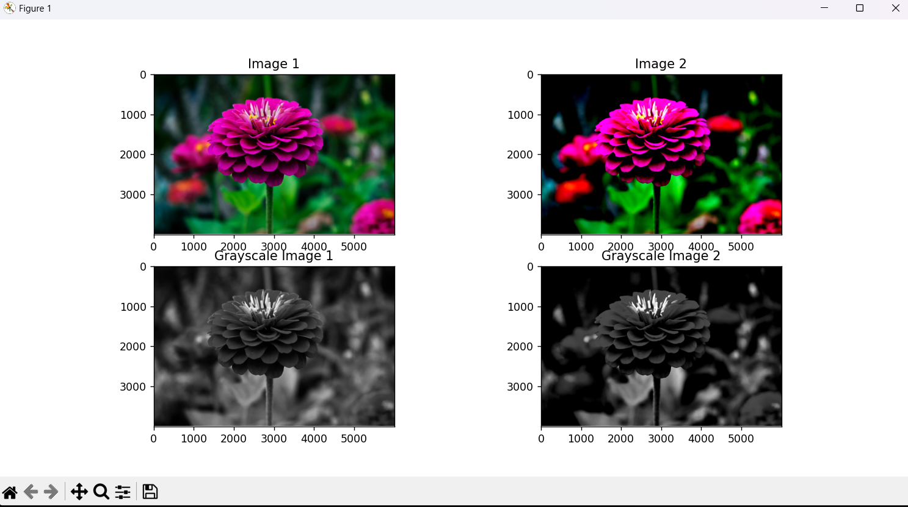
Singular Value Decomposition for Image Similarity Calculation
Image similarity evaluation based on difference in CONTRAST.

Slide 11
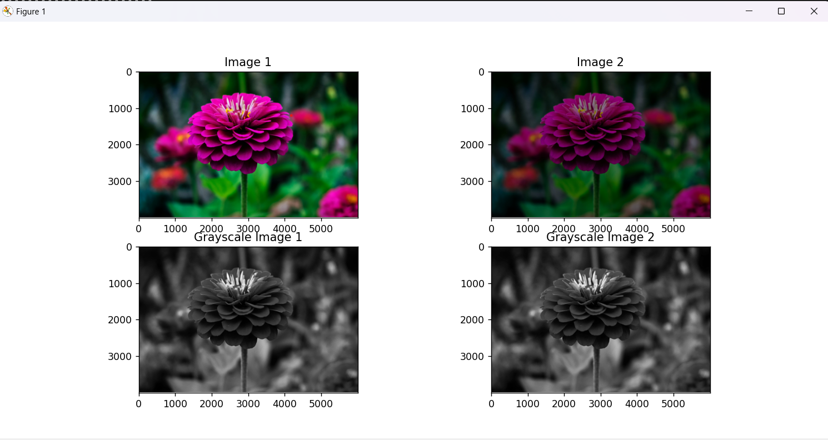
Image similarity evaluation based on difference in BRIGHTNESS

Slide 12
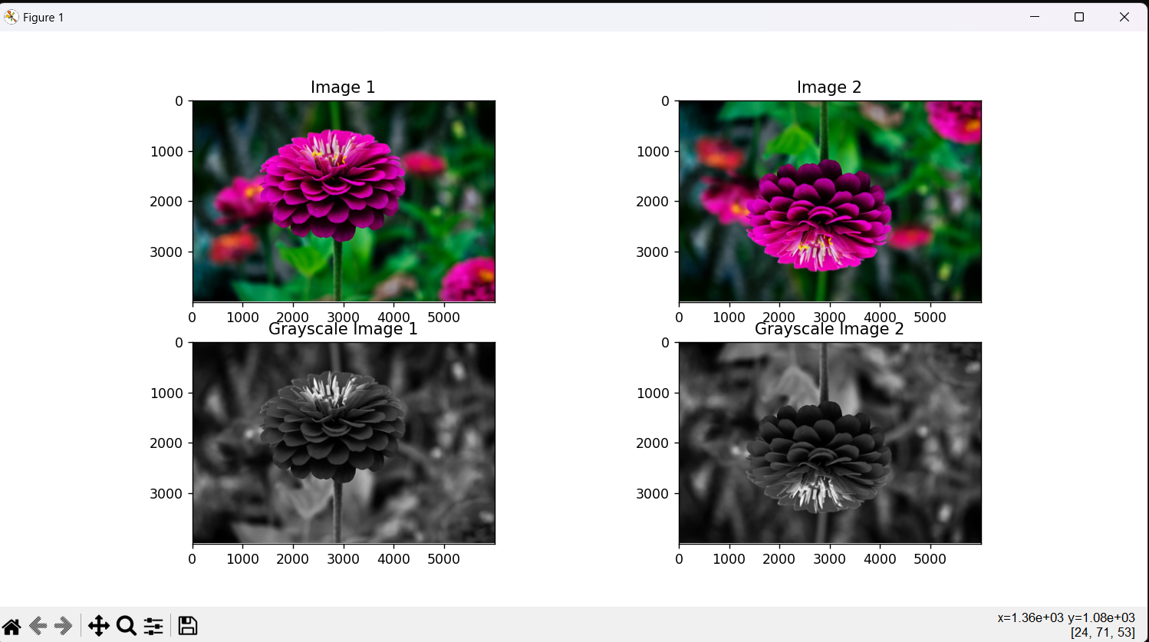
Image similarity evaluation based on difference in IMAGE MIRRORING

Slide 13

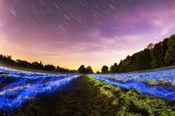
2. KL Divergence for Embedding Distortion of the Image
KL Divergence is the measure of difference between two probability distributions which does not takes account of the overall texture of the image. This metric is not crucial for understanding distortions that involve changes in image structure, geometry, or content.

Slide 14
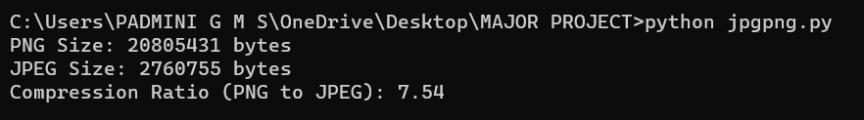
3. Consideration of JPEG Images for the experiment
This code output shows that a JPEG image is taken as input which is the above Image and is converted to PNG. This shows that PNG images are better choice as PNG images tend to have larger file sizes compared to JPEG images because PNG uses lossless compression, preserving all image details and supporting features like transparency. So, the choice of taking JPEG images is not noteworthy.

Slide 15
Proposed Method
Algorithm EnhancedSteganographywith_DualAuthentication_andCamelliaCipherAlgorithm (images, message)
Input: Set of Images, Message
# Stage 1: Image Selection and Preprocessing
selectedImage = ImageSelectionAndPreprocessing(images)
# Stage 2: Receiver Authentication
authenticatedReceiver = AuthenticateReceiver()
if authenticatedReceiver:
# Stage 3: Compression and Encryption
compressed_message = compress(Text)
encryptedMessage = EncryptMessage(message)

Slide 16
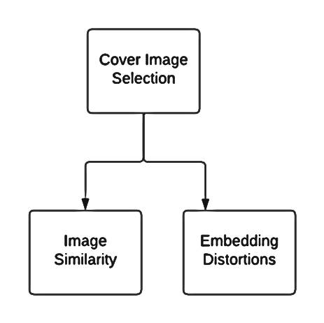
# Stage 4: Steganography
stegoImage = ApplySteganography(selectedImage, encryptedMessage)
# Stage 5: Data Transmission
TransmitStegoImage(stegoImage)
else:
DisplayAuthenticationFailureMessage()
End Algorithm

Slide 17
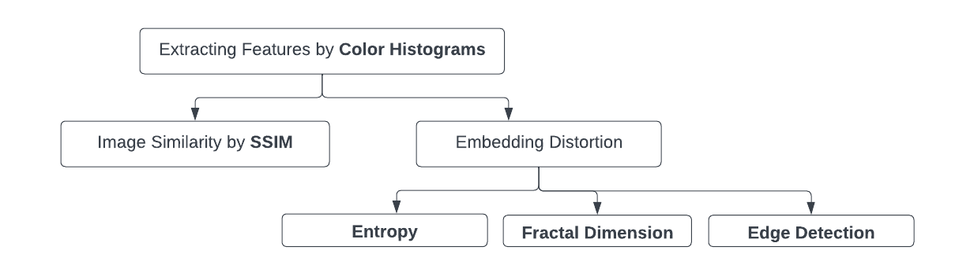
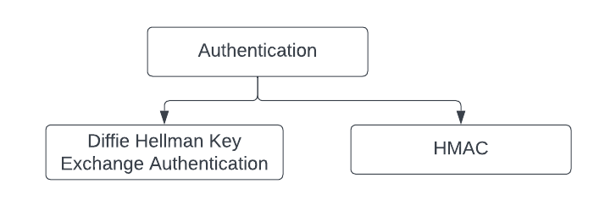


Slide 18
Parameters that are Improved:
Mean Square Error (MSE)
Peak Signal to Noise Ratio (PSNR)
Structure Similarity Index (SSIM)
False Positive Rate (FPR)
False Negative Rate (FNR)

Slide 19
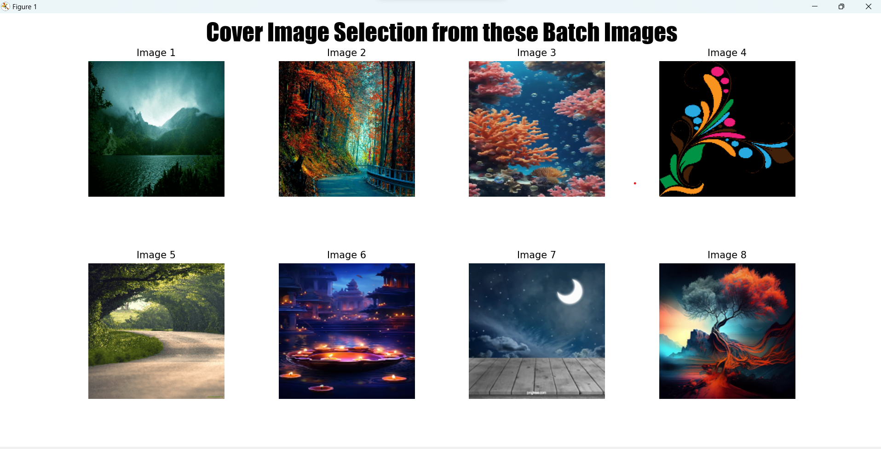
Proposed Method Illustration
Stage 1: Cover Image Selection

Slide 20
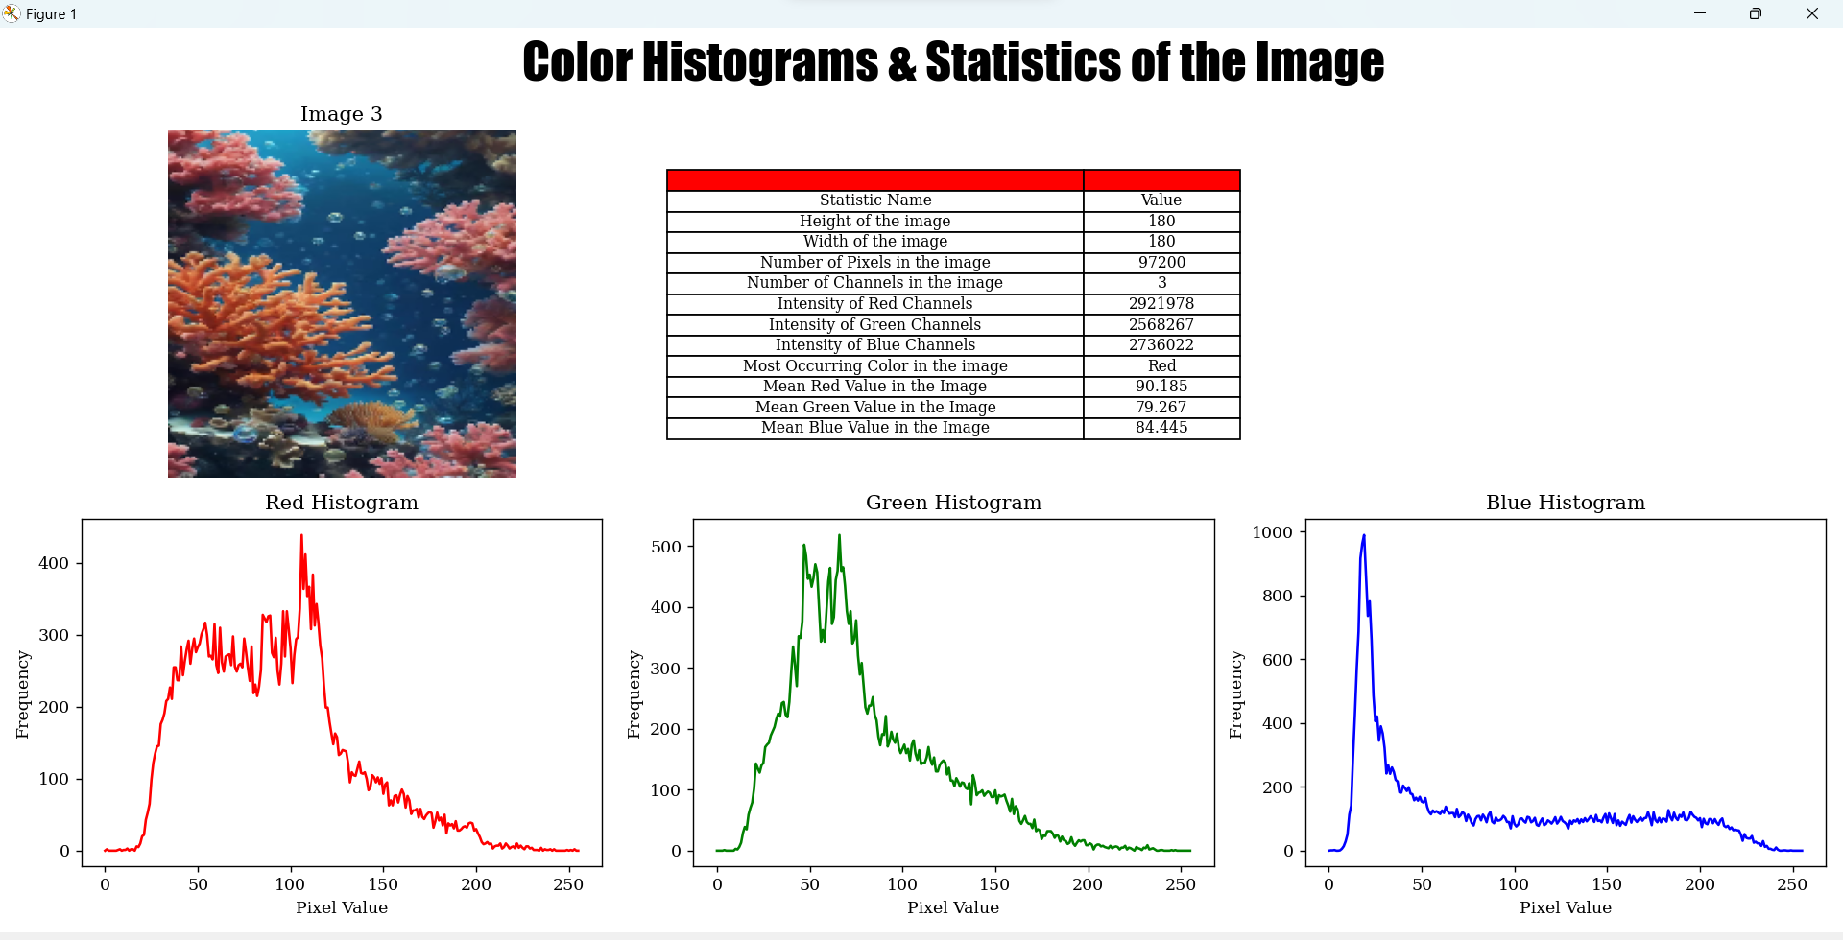

Slide 21
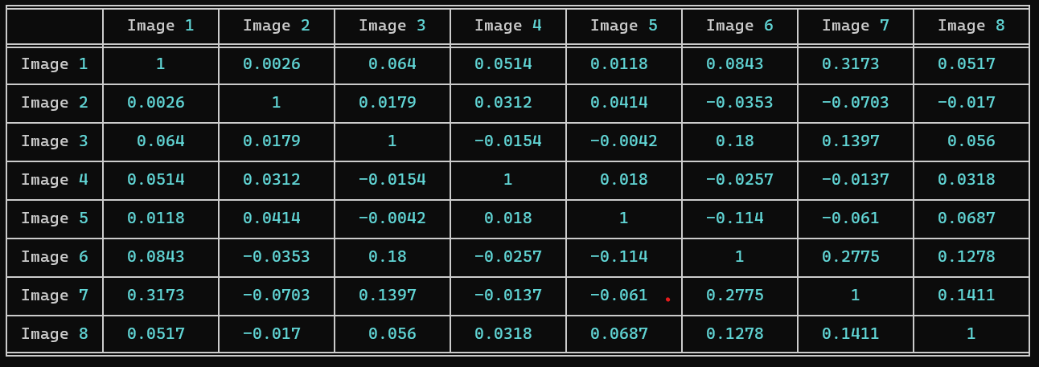
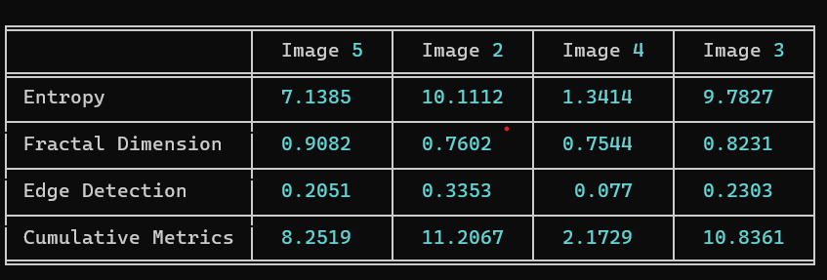
Image Similarity
Embedding Distortion

Slide 22
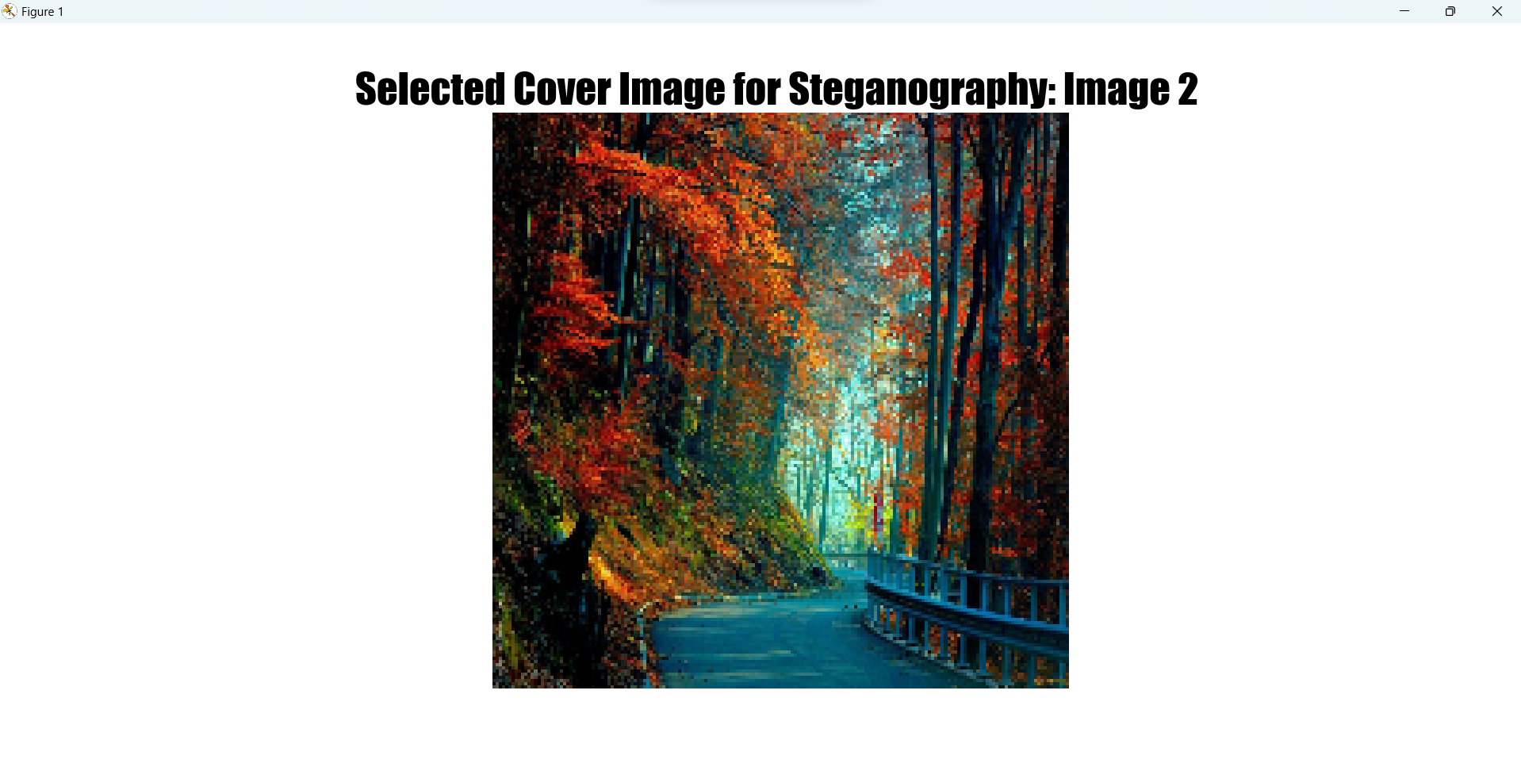

Slide 23
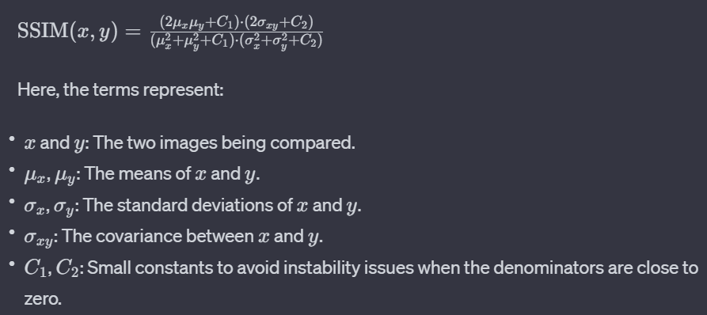
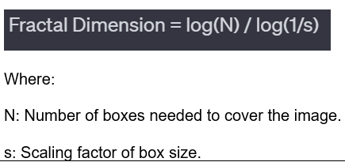
Parameter
1. SSIM
2. Fractal Dimension

Slide 24
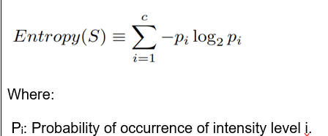
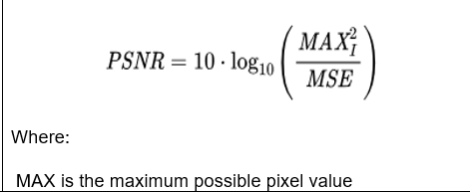
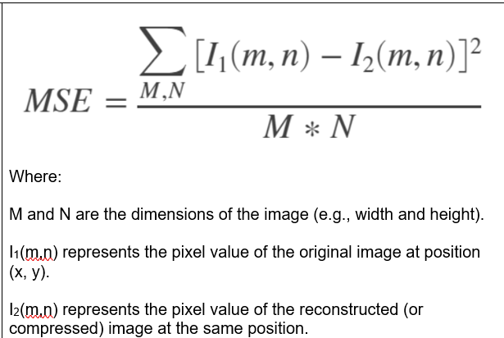
3. Entropy
4. PSNR
5. MSE

Slide 25
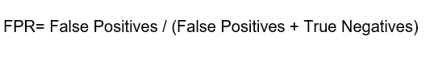
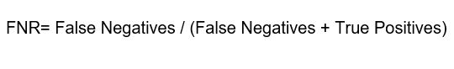
6. FPR
7. FNR

Slide 26
Experiment Environment
The environment used is PYTHON IDLE & COMMAND PROMPT
The packages used in our Python code is:
PILLOW PACKAGE: Used for image processing, to open, manipulate and save various image formats.
OS PACKAGE: To interact with the operating system.
CRYPTOGRAPHY PACKAGE: For all cryptographic related operations.
PYCRYPTODOME PACKAGE: Used in the code for SHA-256, RANDOM.
BASE-64 PACKAGE: Used for particularly in image steganography without causing issues when we use character encoding or special characters.
TERMCOLOR PACKAGE: Used to add the color text, various background colors to output console. Here, we use cprint() function which is used to print the text with different styles and colours.

Slide 27
PYFIGLET PACKAGE: To create ASCII text and attractive headers using font and width
GETPASS MODULE: To read passwords and ensure the passwords and sensitive data is not exposed.
SYS PACKAGE: To work with Python runtime Environment
RANDOM PACKAGE: For the generation of IV
TIME MODULE: To calculate the encryption and decryption time
BINASCII MODULE: To work with binary and ASCII encoded data
NUMPY PACKAGE: To work with arrays or matrices
SCIKIT-IMAGE PACKAGE: For calculating image quality metrics, specifically PSNR (Peak Signal-to-Noise Ratio) and MSE (Mean Squared Error), Other Image Metrics.
OPENCV PACKAGE: For computer vision tasks and image processing.
MATPLOTLIB.PYTPLOT: To create plots and visualizations

Slide 28
Project Status
S.No | Functionality | Status (Completed /in-progress/Not started)
01 | Cover Image Selection based on Image Similarity and Embedding Distortion | Completed
02 | Diffie Hellman Authentication | Completed
03 | HMAC Authentication | Completed
04 | PNG Image Compression | Completed
05 | Text Compression | In-Progress
06 | Camellia Cipher Encryption | In-Progress

Slide 29
07 | LSB Steganography Encoding | Not Started
08 | Camellia Cipher Decryption | Not Started
09 | Camellia Cipher Decryption | Not Started
10 | LSB Steganography Decoding | Not Started
11 | Error Handling & Management | Not Started
12 | Metrics Improvement Display | Not Started

Slide 30
References
[1] Zichi Wang , Guorui Feng , Liquan Shen , and Xinpeng Zhang. “Cover Selection for Steganography Using Image Similarity” IEEE Transactions on Dependable and Secure Computing, VOL. 20, NO. 3, MAY/JUNE 2023.
[2] X. Liao, J. Yin, M. Chen, and Z. Qin, “Adaptive payload distribution in multiple images steganography based on image texture features,” IEEE Trans. Dependable Secure Comput., vol. 19, no. 2, pp. 897–911, Mar./Apr. 2022
[3] T.Kalaichelvi et. al. “Image Steganography Method to Achieve Confidentiality Using CAPTCHA for Authentication”, Proceedings of the Fifth International Conference on Communication and Electronics Systems (ICCES 2020), IEEE Conference Record # 48766.
[4] V. Sachnev, H. J. Kim, and R. Zhang, “Less detectable jpeg steganography method based on heuristic optimization and BCH syndrome coding,” in Proc. 11th ACM Workshop Multimedia Secur., 2009, pp. 131–140.
[5] Sabyasachi Pramanik, Dr.R.P Singh and Ramkrishna Ghosh, “A new encrypted method in image steganography”, Indonesian Journal of Electrical Engineering and Computer Science, Volume: 14 No: 3

Slide 31
References
[6] Alaa A. Jabbar Altaay et. al., “An Introduction to Image Steganography Techniques”, 2012 International Conference on Advanced Computer Science Applications and Technologies
[7] T. Qiao, X. Luo, T. Wu, M. Xu, and Z. Qian, “Adaptive steganalysis based on statistical model of quantized DCT coefficients for JPEG images,” IEEE Trans. Dependable Secure Comput., vol. 18, no. 6, pp. 2736–2751, Nov./Dec. 2021.
[8] Altaay A., bin Sahib S., and Zamani M., "An Introduction to Image Steganography Techniques," in Proceedings of International Conference on Advanced Computer Science Applications and Technologies, pp. 122-126
[9] N. Krishnaveni and Sudhakar Periyasamy, “A Novel and Innovative Approach for Image Steganography with Chaos”, Indonesian Journal of Electrical Engineering and Computer Science, Vol. 11, No. 1, July 2018, pp. 263~267.

Slide 32
References
[10] Adit Pabbi et. al. “Implementation of Least Significant Bit Image Steganography with Advanced Encryption Standard”, 2021 International Conference on Emerging Smart Computing and Informatics (ESCI) AISSMS Institute of Information Technology, Pune, India. Mar 5-7, 2021
[11] Utsav Sheth and Shiva Saxena, “Image Steganography Using AES Encryption and Least Significant Nibble”, International Conference on Communication and Signal Processing, April 6-8, 2016, India
[12] Zoran Cica, “Pipelined Implementation of Camellia Encryption Algorithm”, IEEE 2016 24th Telecommunications Forum (TELFOR)

Slide 33
Thank You

Slide 34
Project seminar–I Evaluation
S.No | Rubrics | Marks
1 | Concept Introduction | 4
2 | Literature and Parameter | 5
3 | Problem and Problem Illustration | 8
4 | Proposed Method and Illustration | 8
Total |  | 25

